Slide 1
Presented By:
Dipkumar Patel
Noopa Jagadeesh
Prasanth Varma
Visualization Viewpoints
Toward Measuring Visualization Insight
Editor: Theresa-Marie Rhyne

Slide 2
Agenda
Introduction
Defining insights
Controlled experiments on benchmark tasks
Eliminating benchmark tasks
Conclusion and Future Scope

Slide 3
Introduction
2005 IEEE Visualization conference had many of the presentations related to evaluating visualizations.
There were also papers related to Boolean usability studies that offered two alternatives: either the users liked the visualization tool in question, or they did not.
There was papers related to variety of rigorously controlled experiments.

Slide 4
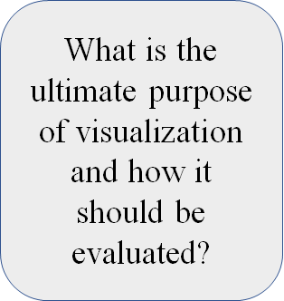

Introduction

Slide 5
Defining insight
Insight has been commonly stated as the broader purpose of information visualization by many authors.
However, for the most part, the definition of insight remains fairly informal, making success difficult to evaluate.
A default and implicit definition is to equate insight with user tasks, such as finding extreme values.

Slide 6





Defining insight
The essential characteristics of insight are:

Slide 7
Evaluating visualizations
A variety of evaluation methods exist:
Controlled experiments
Usability testing
Longitudinal studies
Heuristic evaluation
Cognitive walkthroughs

Slide 8
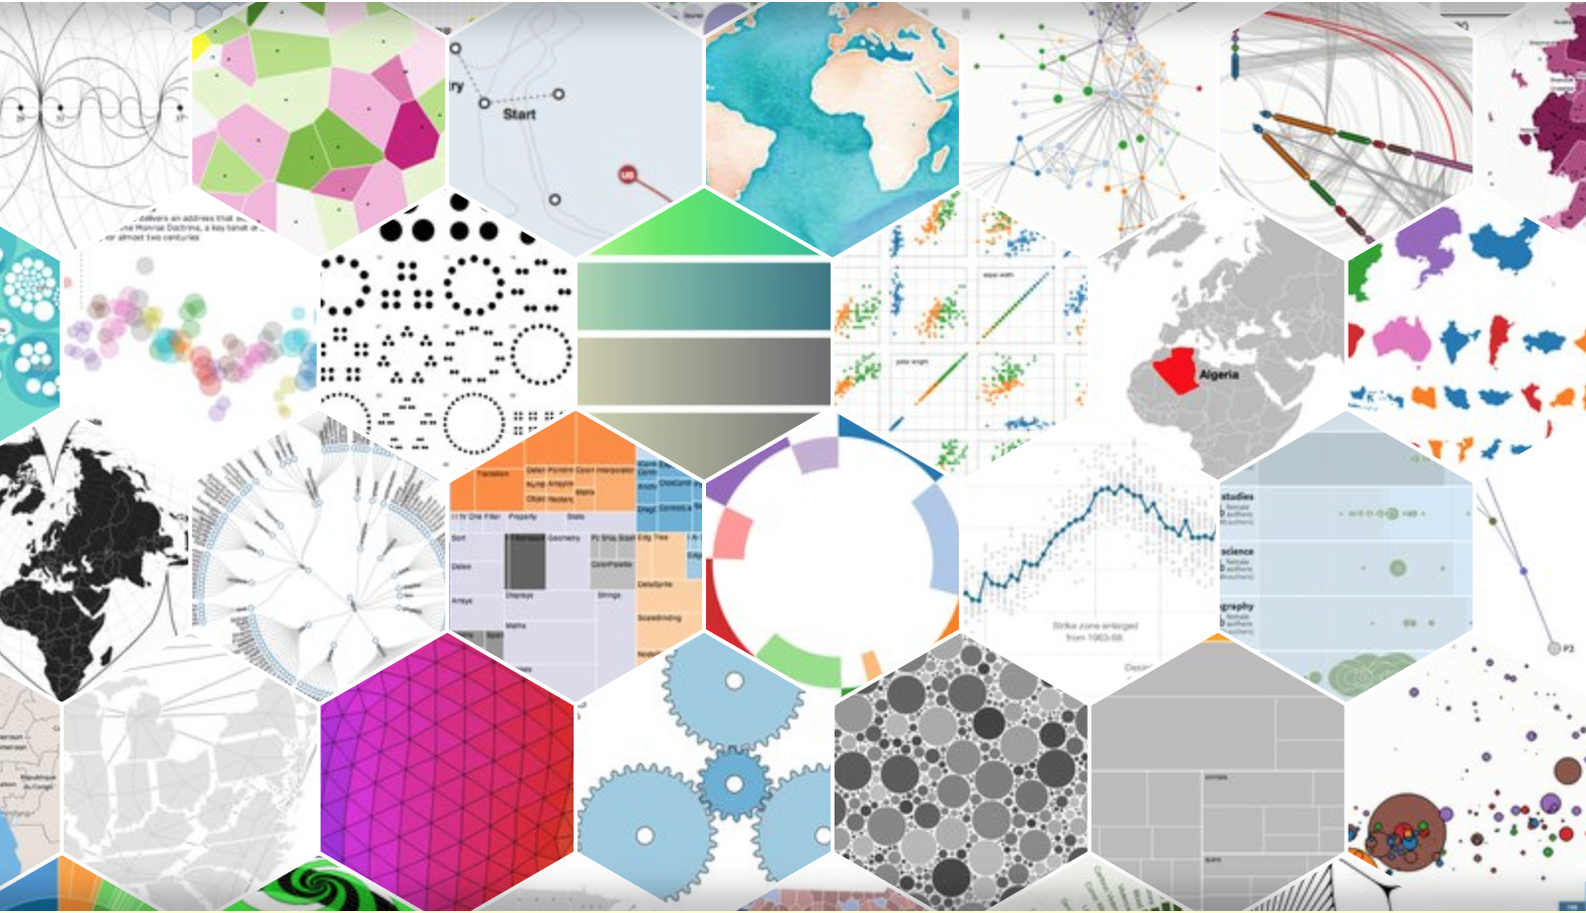
Evaluation of Visualization
What is a controlled
experiment?
What is a benchmark
test?

Slide 9
Characteristics
Predefined Tests
Definitive Completion Times
Definitive and Simple Answers

Slide 10
Drawbacks of Benchmark Tasks
Predefined tasks can be biased. The experiment results are limited to only the tasks that evaluator chose.
A further confusion in the interpretation of benchmark experiment results is the tradeoff between performance and accuracy.

Slide 11
Toward insight: more complex benchmark tasks
To include benchmark tasks of greater complexity. For example, a task to characterize the distribution of data values (normal/ uniform/ linearly increasing ).
Another possibility is estimation tasks.

Slide 12
Difficulties in Complex benchmark texts
Greater variability in task times and correctness.
Greater difficulty in designing isomorphic tasks.
Together, these problems generally mean that we must test more participants to get statistically significant results.

Slide 13

Toward insight: eliminating benchmark tasks
- change the benchmark tasks from an independent to a dependent variable
Instead of instructing users in exactly what insights to gain, researchers observe what insights users gain on their own.
Open ended protocol - Users explore the data in a way that they choose

Slide 14
Toward insight: eliminating benchmark tasks(contd…)
Users are instructed to explore the data and report their insights until they feel that they have learned all that they can from the data
Coding method metrics:
Insight category
Complexity
Time to generate
Errors
Depth - [coded 1 to 5]
Users should be from the target domain

Slide 15
Toward insight: eliminating benchmark tasks(contd…)
Advantage: It reveals what insights visualization users gained
Researchers can then compare visualizations on insight related measures such as,
Number of insights
Speed at which insights were generated
Domain value of the insights
Insights gained by users vs. insights expected
Which features of the visualization helped achieve insight, and which caused problems for the users?
This directly leads to visualization refinement and improvement

Slide 16
Toward insight: eliminating benchmark tasks(contd…)
Problems:
Long insight time depending on data and domain complexity
More effort by the experimenters to capture and code results
Motivated, domain knowledgeable users who will not merely follow instructions but generate insight in a self-directed manner
Domain experts to assist in coding results along with visualization experts

Slide 17

Conclusion
Both types of controlled experiments are needed:
Benchmark tasks experiments: Identifies low-level effects
Eliminating Benchmark Tasks: Provide richer view of the broader insight of visualization
Expects a better results, If both approaches are combined into single
Future Steps:
Try running the same experiment with each method to see how they differ
Examine and adapt other uncontrolled evaluation methods to better gauge insight
Ultimately determine whether visualizations are achieving their grand purpose

Slide 18
Resources
R. Amar, J. Eagan, and J. Stasko, “Low-Level Components of Analytic Activity in Information Visualization,” Proc. IEEE Symp. Information Visualization, IEEE Press, 2005, pp. 111-117
C. Plaisant, “The Challenge of Information Visualization Evaluation,” Proc. Working Conf. Advanced Visual Interfaces (AVI), ACM Press, 2004, pp. 109-116.
M. Tory and T. Möller, “Human Factors In Visualization Research,” IEEE Trans. Visualization and Computer Graphics, vol. 10, no. 1, 2004, pp. 72-84
C. Chen, and Y. Yu, “Empirical Studies of Information Visualization: A Meta-Analysis,” Int’l J.Human–Computer Studies, vol. 53, no. 5, 2000, pp. 851-866
P. Saraiya, C. North, and K. Duca, “An Insight-Based Methodology for Evaluating Bioinformatics Visualizations,” IEEE Trans. Visualizations and Computer Graphics, vol. 11, no. 4, 2005, pp. 443-456

Slide 19


